Slide 1

PROJECT
UK TRAIN RIDES
REPORT
P R E S E N T A T I O N

Slide 2



Team Members
Mohamed Ahmed
mohamed reda
Hossam Mohamed
Noran Mohamed
Eman Ahmed
Amany Gamal

Slide 3
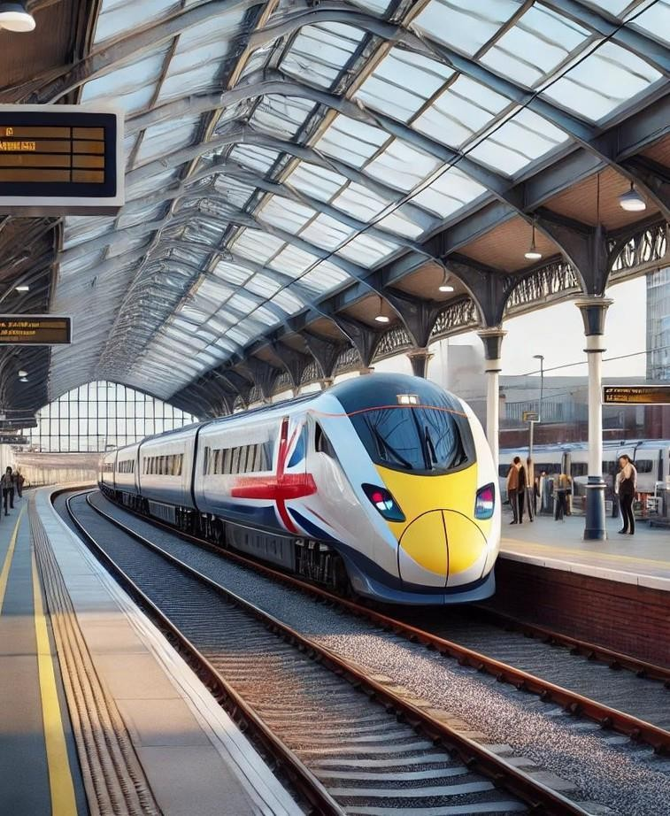
Introduction
The "UK Train Rides Report" project was developed to provide a comprehensive and detailed analysis of railway operations in the United Kingdom. This report is the result of a collaborative effort focused on
identifying operations, experience
and resolving critical issues in train as well as optimizing the passenger

Slide 4
Project Phases
Questions
Data Cleaning
DAX
2
ETL
4
Normalization& Data Modeling
6
Visualization
1
3
5

Slide 5


Data Analysis Questions

Slide 6
Questions
§ Performance Analysis
What percentage of total trips were cancelled or delayed?
Which routes experience the highest number of delays or cancellations?
§ Revenue Analysis
Which Stations generate the most revenue?
What is the revenue loss due to cancelled or delayed trips?
Is there a seasonal or monthly trend delays, or cancellations?
§ Operational Efficiency
Are certain time periods (days of the week, months) more prone to delays or cancellations?
What are the average delay durations per route or trip type?
§ Comparative Questions
How do high-performing Stations differ from low-performing ones in terms of trips, revenue, and delays?
what is the trend of trip volume and performance over time — is it improving or declining?

Slide 7
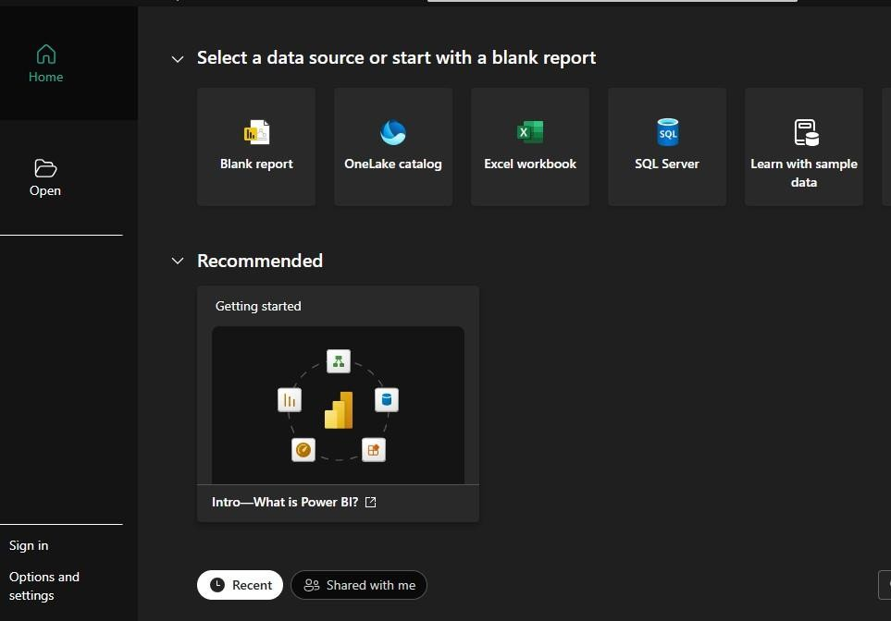
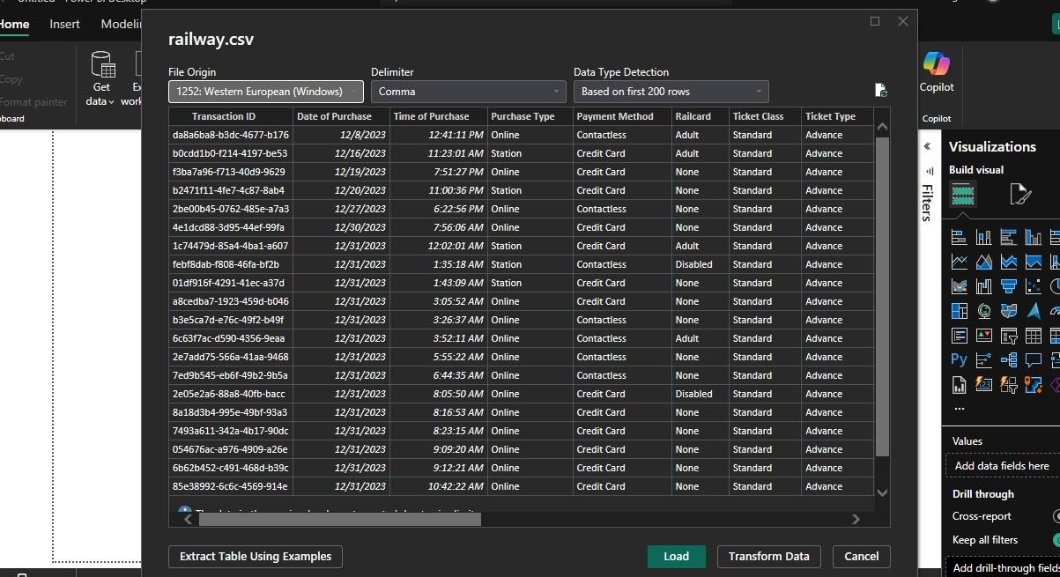
ETL

Slide 8
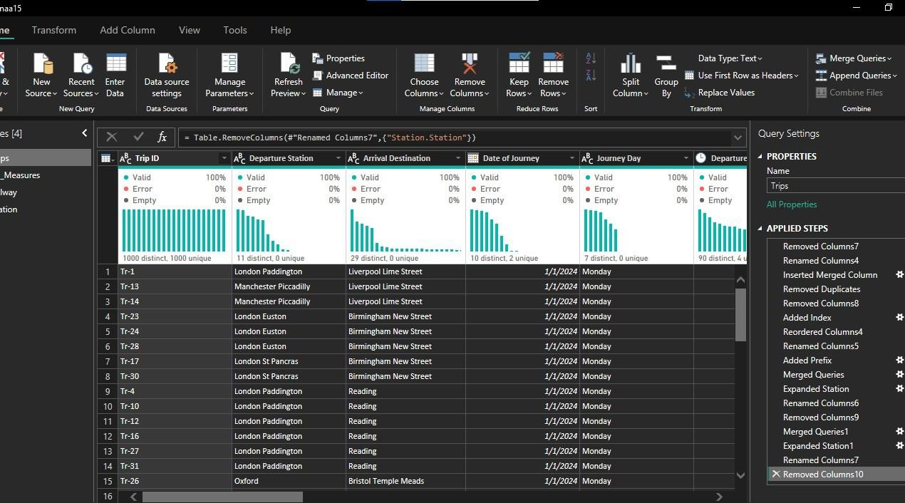
Data Cleaning

Slide 9
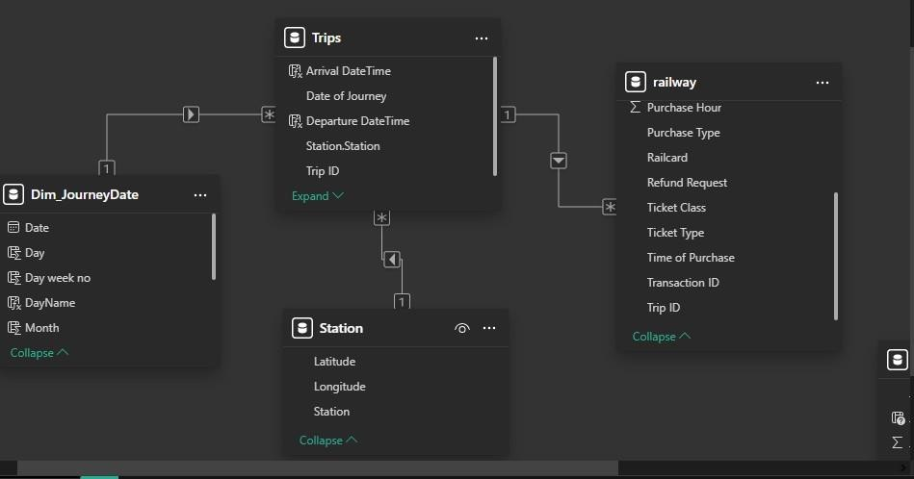
Normalization& Data Modeling

Slide 10
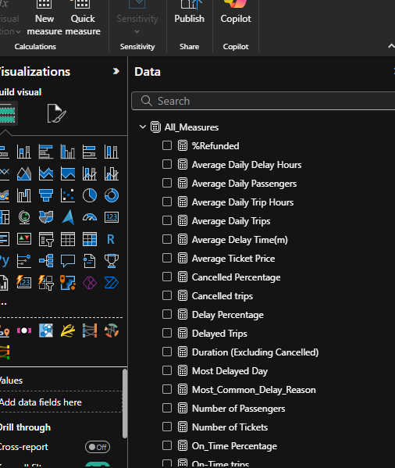
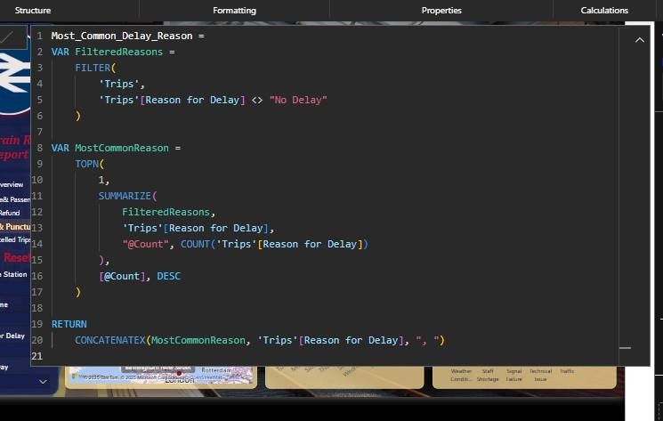
DAX

Slide 11
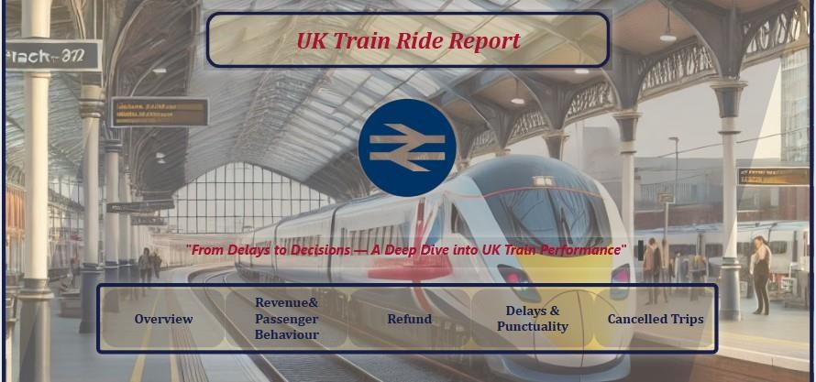
Visualization
Cover

Slide 12
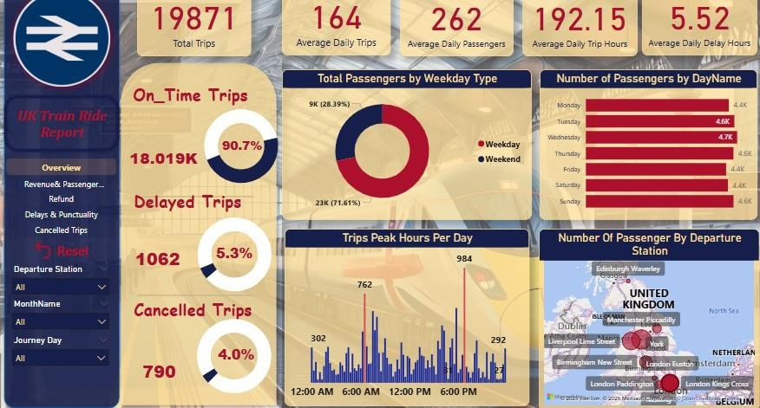
Visualization
Overview

Slide 13
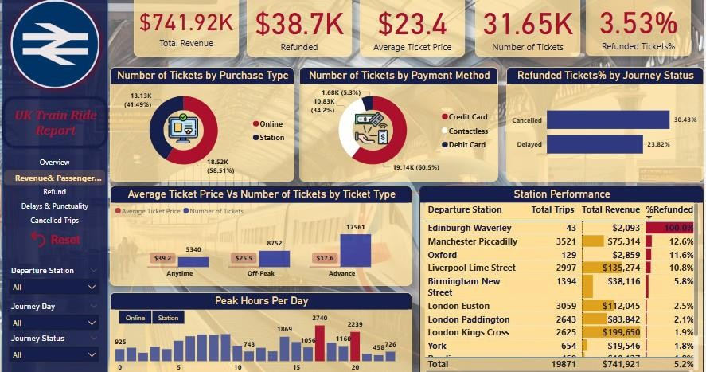
Visualization
Revenue& Passenger Behaviour

Slide 14
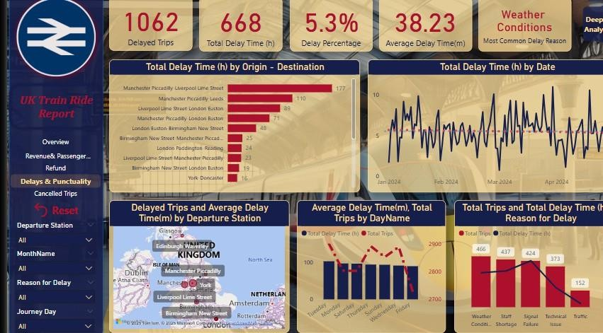
Visualization
Delays& Punctuality

Slide 15
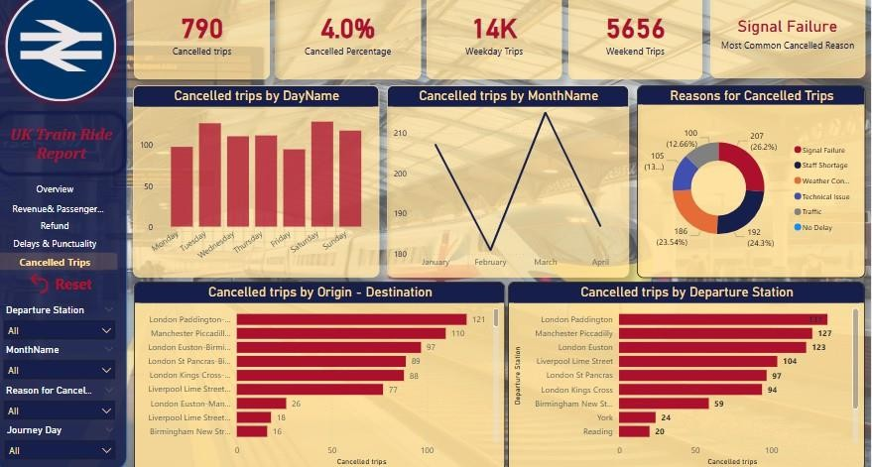
Visualization
Cancelled Trips

Slide 16

Conclusion& Recommendations
Priority Actions: Resolve signal failures and staff shortages to cut cancellations by 30% in 6 months.
Quick Wins: Introduce flexible pricing for off-peak travel and improve weather-related contingency plans.
Long-Term Strategy: Invest in infrastructure and workforce stability to boost punctuality beyond 90.7%.

Slide 17


